Slide 1
Presolar Grain Isolation:
A Novel Development Using Focused Ion Beam (FIB)
Ethan Duncan^{1,2α}
Maitrayee Bose^{1α} and Kenneth Mossman³
¹School of Earth and Space Exploration, ²Department of Physics
^{α}Center for Isotope Analysis (CIA) and ³Eyring Materials Center

Slide 2
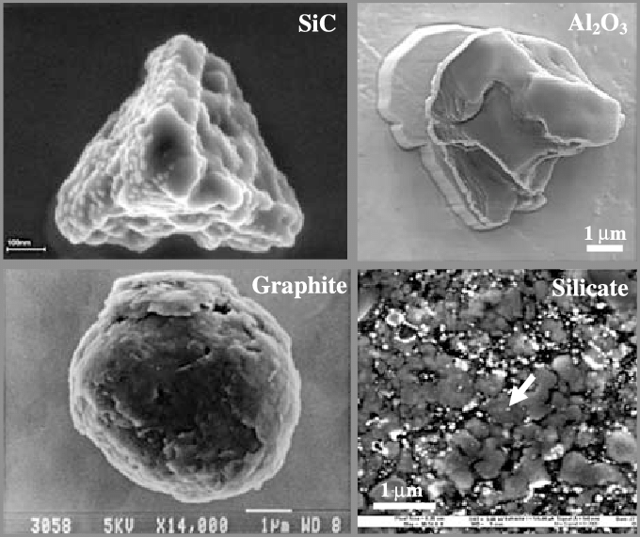
Background
Presolar Grains:
Small dust grains condense in the expanding atmospheres of red giant and asymptotic giant branch stars as well as in the ejecta of supernovae (Bose et al 2010)
For the purposes of this study, I will be looking at presolar silicate grains.
Scanning electron microscopy (SEM) images of circumstellar (presolar) dust found in meteorites. (Peter Hoppe et al 2007)

Slide 3
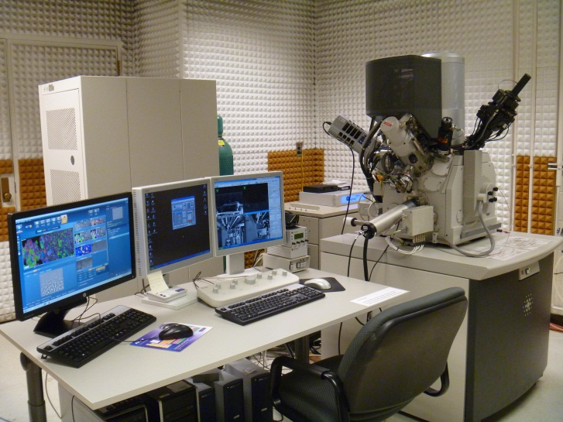
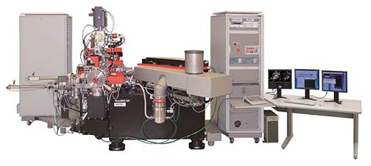
Methods (Instruments):
Focused Ion Beam (FIB)
Nano-scaled Secondary Ion Mass Spectrometry
(NanoSIMS)
Source: ASU Center for Isotope Analysis (CIA)
Source: ASU Eyring Materials Center

Slide 4
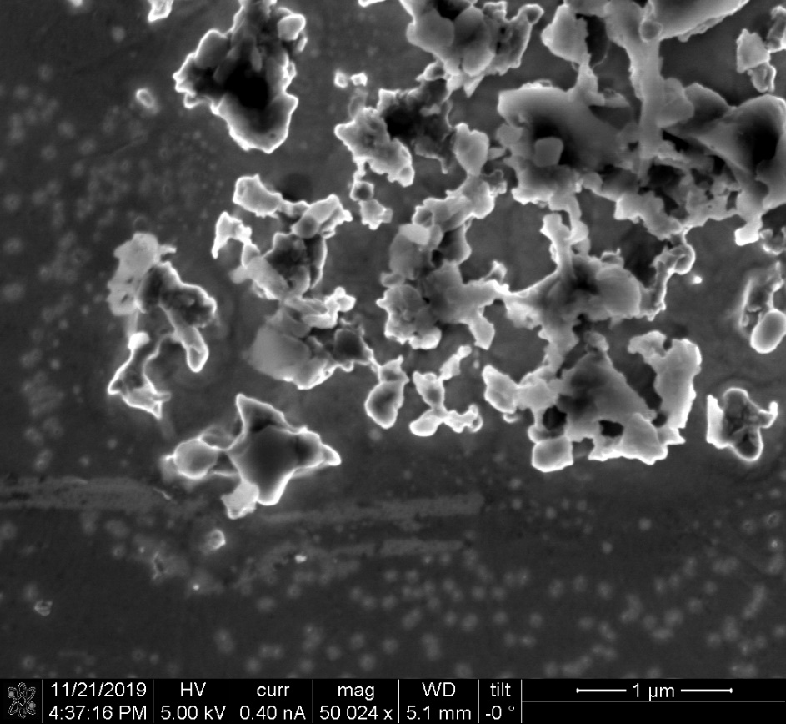
Methods (Techniques)
Problem:
The presolar grains that we want to analyze are so small (~50-200 nm) that when we try to analyze them in the NanoSIMS the beam size covers more than one grain.
Solution:
Develop a technique to isolate presolar grains in meteorites using FIB milling for future NanoSIMS measurements.
~NanoSIMS Beam Size
Presolar Grain

Slide 5
Methods (Procedures 1/3)
Attach presolar grain mount to carbon tape and place onto FIB stage
Identify tiny test grains using the secondary electron microscope (SEM)
Acfer 094 42C meteoritic grain 6 (pre-FIB image)

Slide 6
Methods (Procedures 2/3)
Use Pt dispenser to place a ~50-75 nm cap on identified meteoritic grain
Acfer 094 42C meteoritic grain 6 (after Pt cap)

Slide 7
Methods (Procedures 3/3)
Mill outer circle of 1 𝜇m radius using Ga⁺ ion beam with ~50 pA current
Mill inner circle of 200 nm radius using Ga⁺ ion beam with ~30 pA current
Acfer 094 42C meteoritic grain 6 (after FIB)

Slide 8
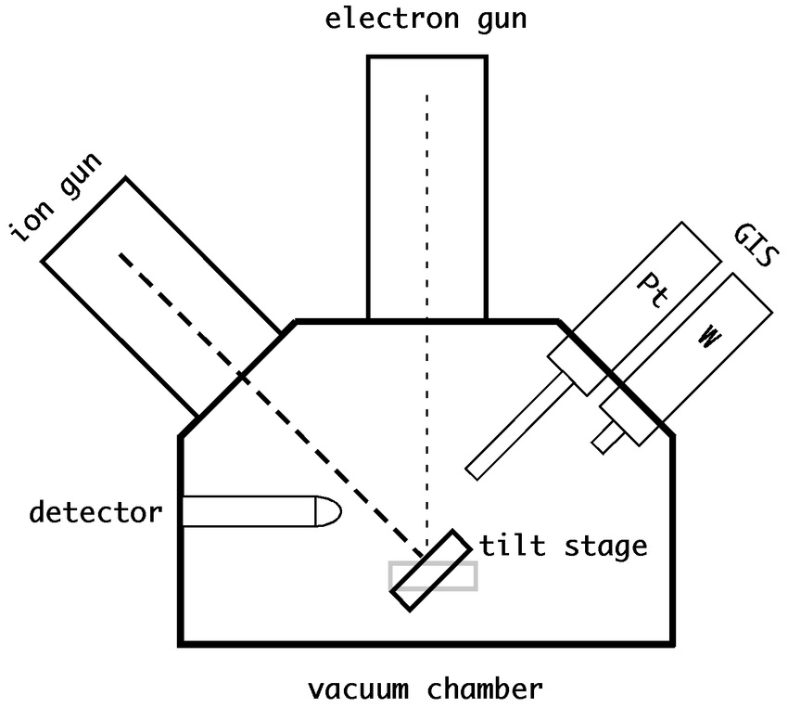
Results (1/2)
Focused Ion Beam (FIB)
Using meteoritic grains as practice, we realized the limitation of Focused Ion Beam - Nova 200 NanoLab (FEI) instrument. The two limitations were as follows:
1. Sample Drift: As a result, carbon tape was used to attach the sample mount onto the FIB mount, large drifts would occur, which could potentially destroy <300 nm grains. Using a mechanical holder to hold samples might reduce the drift.
Source: Ritter, Martin. (2007). A landmark-based method for the geometrical 3D calibration of scanning microscopes.

Slide 9
Results (2/2)
2.Pt dispenser: The dispenser can only create ~300 nm Pt caps on grains. As a result, the Pt dispenser coats not just the grain of interest but also the grains surrounding the target grain obscuring it from view and decreasing the likelihood of a successful grain isolation.
Before
After

Slide 10
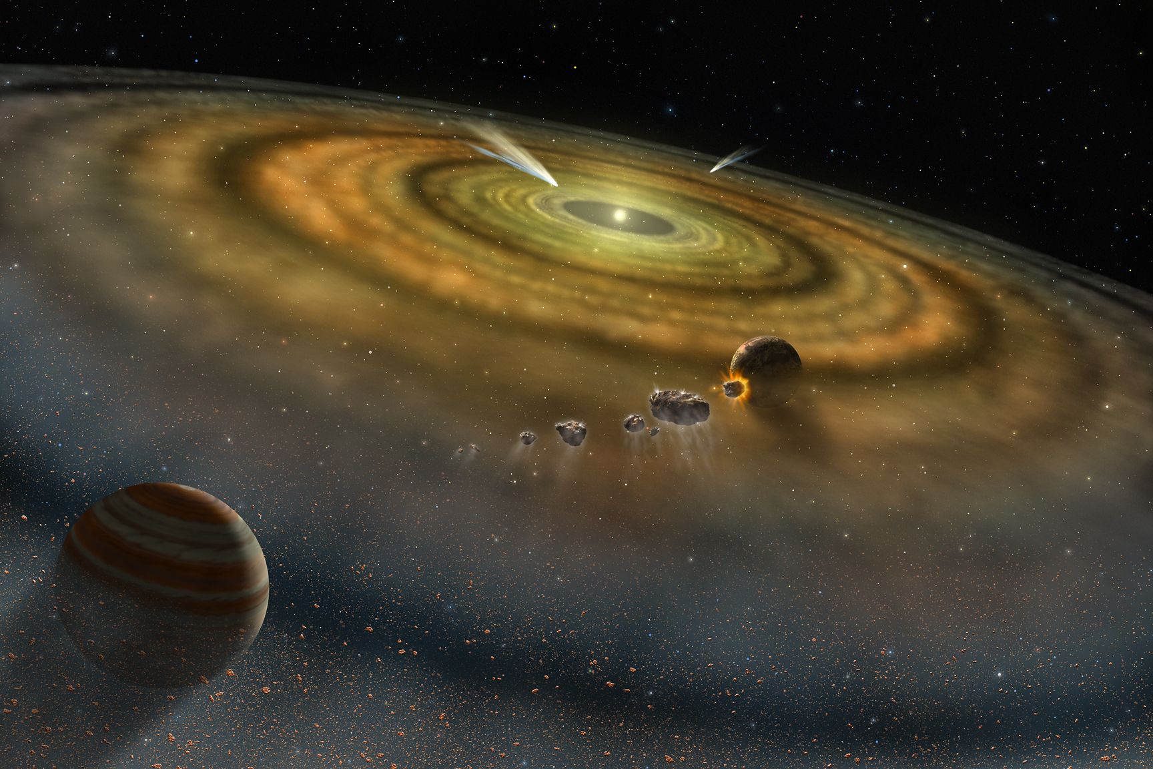
Conclusions
We proved that the current FIB instrumentation cannot be used to prepare presolar grains smaller that 1 𝜇m for NanoSIMS analysis.
Recently, Dr. Peter Williams, director of the Center for Isotope Analysis, created a new NanoSIMS part that get the beam size down to ~50-75 nm. I will use new advance in technology to analyze the small presolar grains on the NanoSIMS
Source: NASA

Slide 11
Questions?
Many thanks to ASU/NASA Space Grant for funding this research

